Slide 1


Slide 1
Livescript oops…
Javascript
Train

Slide 2

Slide 2
What is Javascript?
JavaScript is one of the core technologies of the World Wide Web, alongside HTML and CSS.
JavaScript enables interactive web pages and is an essential part of web applications.
The vast majority of websites use it, and major web browsers have a dedicated JavaScript engine to execute it.
Designer of JS?
Brendan Eich,
Netscape Communication Corporation,
1995
ECMA Script
It was created to standardize JavaScript, so as to foster multiple independent implementations.
Train
2

Slide 3
Slide 12
Javascript can change HTML content
document.getElementById("demo").innerHTML = "Hello World";
document.getElementById("demo").style.color = “skyblue";
<!DOCTYPE html>
<html>
<body>
<h2>Document Object Model Computation</h2>
<p id="demo">JavaScript can change DOM</p>
<button type="button" onclick='document.getElementById("demo").innerHTML = "Hello World!"'>Don’t click!</button>
</body>
</html>
Train
15

Slide 4
Slide 12
<SCRIPT>
Where do we write Javascript code in HTML?
Code inside <script> Tag
<script> document.getElementById("demo").innerHTML = "My First JavaScript"; </script>
External JS File
<script src="myScript.js"></script>
It separates HTML and code
It makes HTML and JavaScript easier to read and maintain
Cached JavaScript files can speed up page loads
Train
15

Slide 5
Slide 12
Document.write, alert, console.log
Document.write
Writes the data in the HTML
Console.log
Prints data in the console
Alert
Pops an alert box in the HTML file
Train
15

Slide 6
Slide 12
Var, let and const
Var:
Function scope, can be changed
Let:
Block Scope, can be changed
Const:
Block scope, cannot be changed
Train
15

Slide 7
Slide 12
Comment
Single Line:
//single line comment
Multiline:
/*
This is a multiline
comment
*/
Train
15

Slide 8
Slide 12
Operators
= Assignment
+ Addition
- Subtraction
/ Division
* Multiplication
** ???
% Modulo
++ Incremenet
-- Decrement
== ???
=== ???
+=,-=,*=,/=,%= ???
&& ???
|| ???
Train
15

Slide 9
Slide 12
Data Types
String
Number
Boolean
Object
Type Coercion
Lets see it in the console……………………
Train
15

Slide 10
Slide 12
IF
if(condn){
….
statements
….
}
else if(condn){
….
statements
….
}
else{
}
Train
15

Slide 11
Slide 12
Ternary Operator
condition?exec if true:exec if false
Eg:
1+1===2?console.log(true):console.log(false)
Train
15

Slide 12
Slide 12
Functions
function myFunction() {
console.log("Hello World!");
}
Vs
myFunction =()=>{
console.log("Hello World");
}
Train
15

Slide 13
Slide 12
Loops
for:
for(var i=0;i<=10;i++){
console.log(i)
}
while
var i=0;
while(i<=10){
console.log(i);
i++
}
do while
var i=0;
do{
console.log(i);
i++
}
while(i<=10)
contine and break statments
Train
15

Slide 14
Slide 12
What’s coming?
Strict mode
string and array functions
map, reduce, filter
Hoisting
Spread operator
Closure
Callback
Promise
Train
15

Slide 15
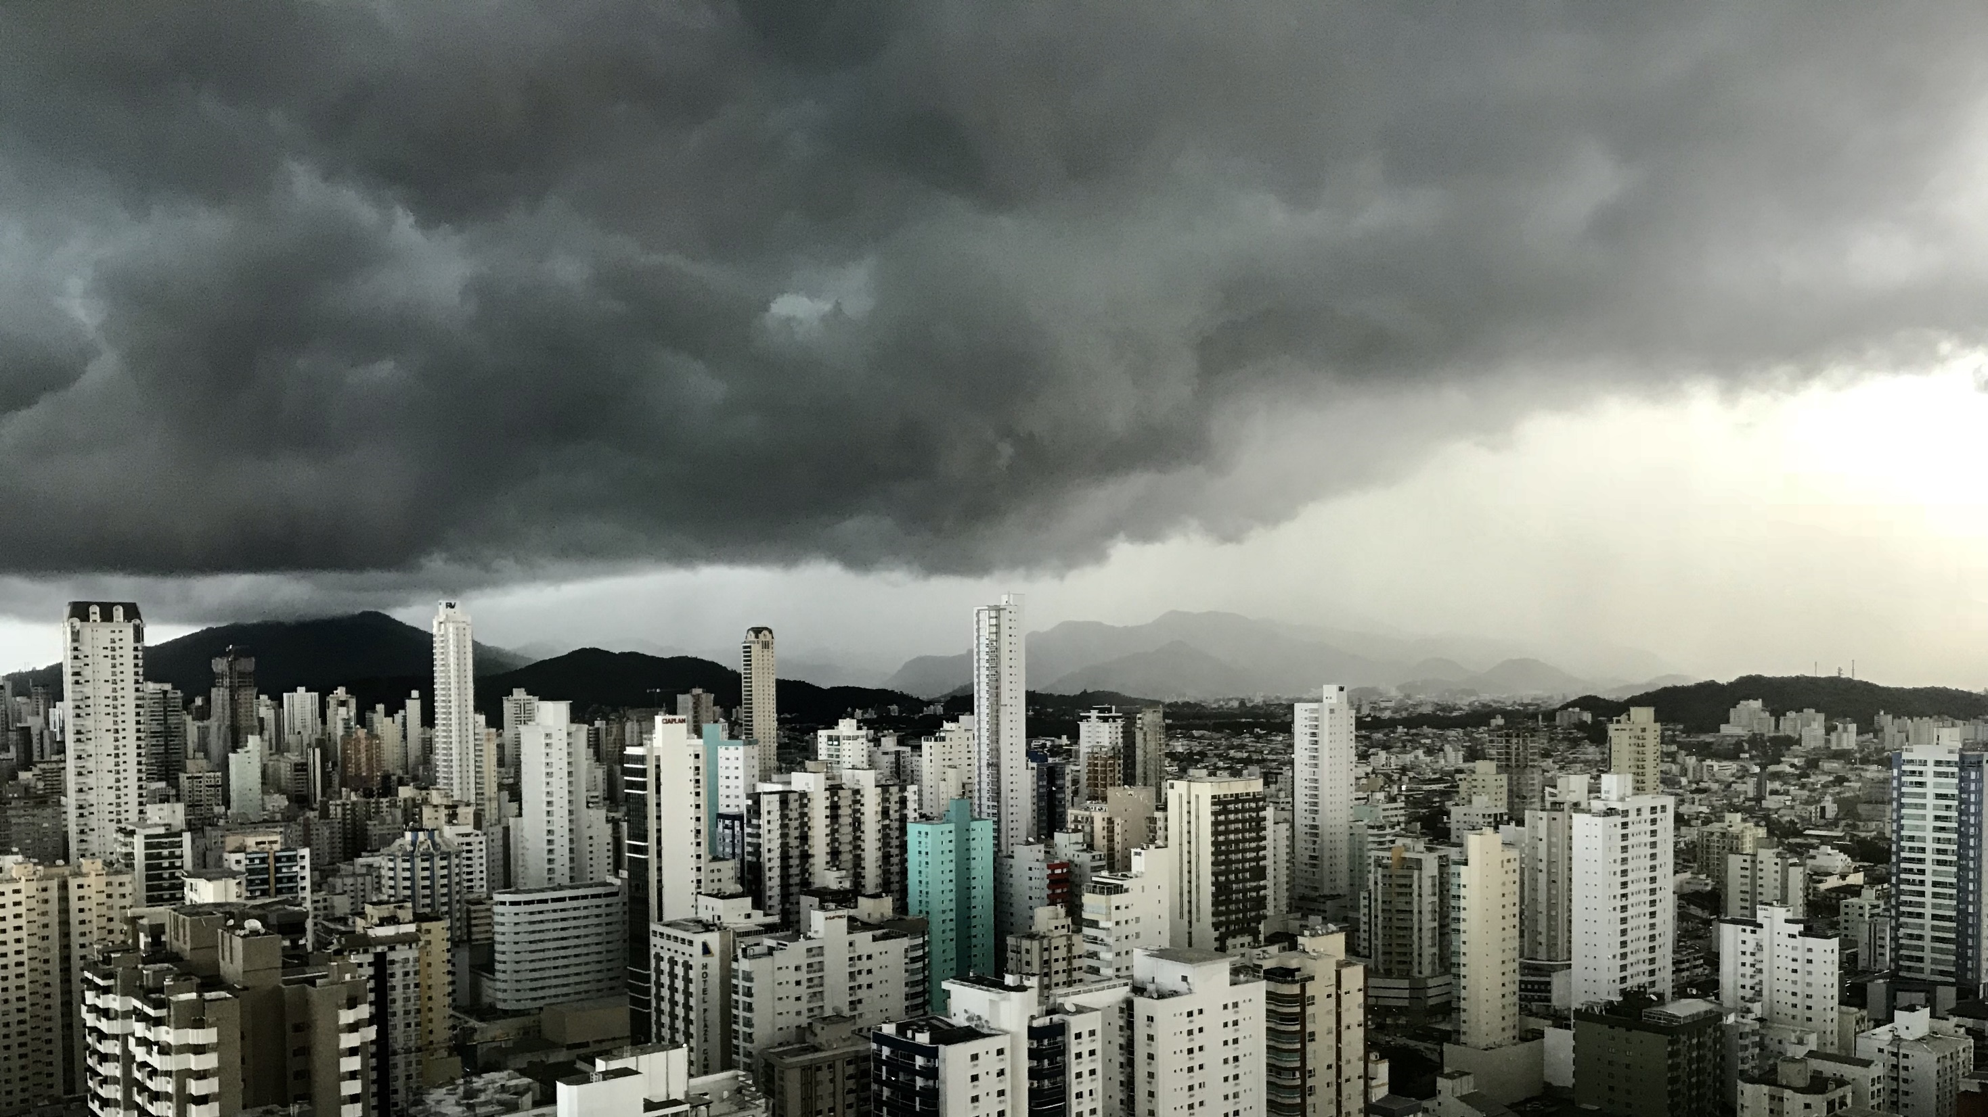
Slide 11
Assignment Time
Give number is even or odd
Addition, Subtraction, Division, Multiplication, Reminder
Fibonacci series
Given number is prime or not
Train

